Slide 1
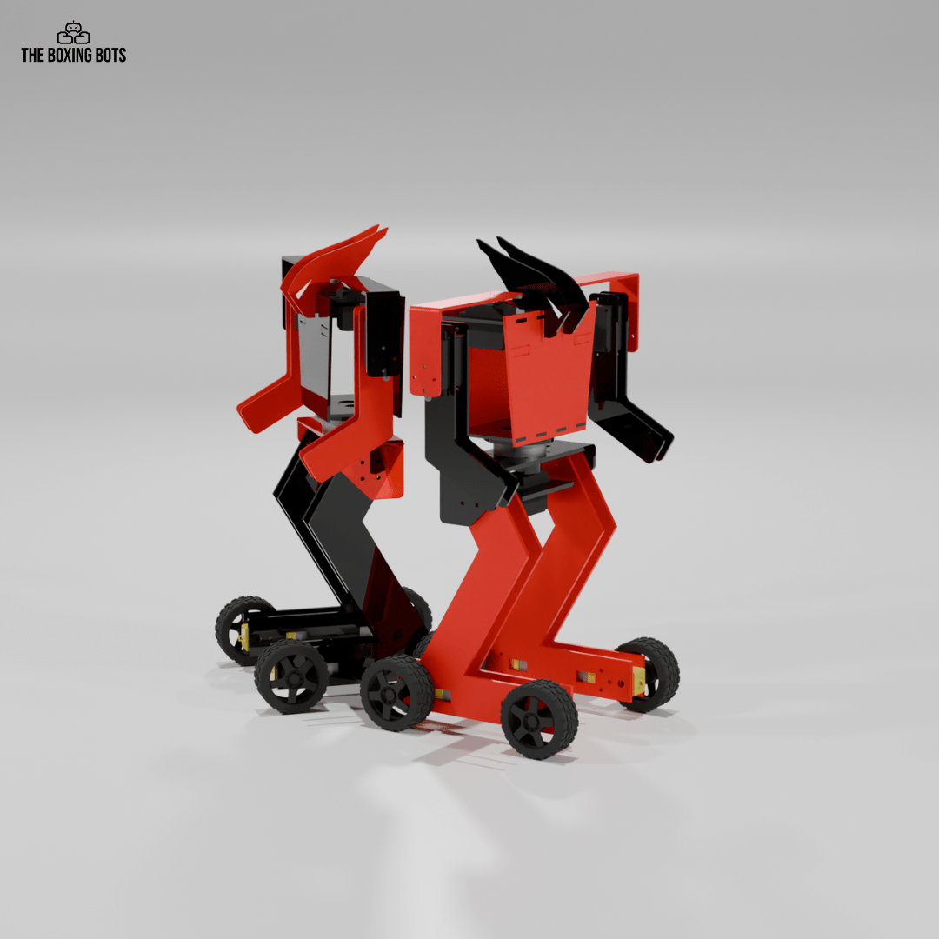
BOXING BOTS

Slide 2
Electronic Components
ESP32
Servo Motor(MG995)
BO-Motors
Battery(7.4V)
Buck converter(LM2596)
PS4 controller
Boxing bot PCB

Slide 3
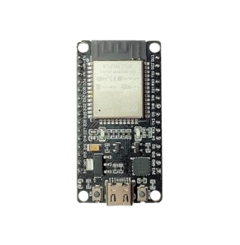
ESP32
Wi-Fi and Bluetooth: Offers wireless connectivity for IoT and remote control.
Fast Processor: It has two mini-brains to handle tasks quickly.
Many Pins: Can connect to sensors, motors, lights, and more.
Low Power: Various power-saving modes, ideal for battery-powered devices.
Easy to Program: Programmable with Arduino IDE or other tools.
Applications: Perfect for IoT, robotics, smart homes, wearables, and automation projects.

Slide 4
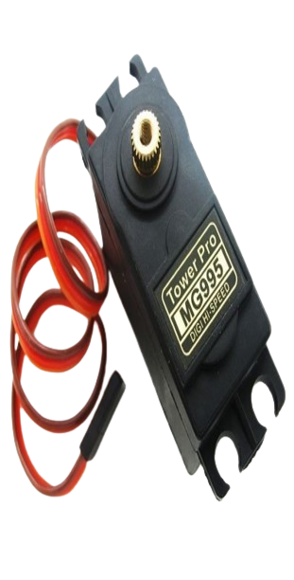
Servo Motor
Rotates Precisely: The MG995 can rotate between 0° to 180° based on commands, making it great for controlled movements like steering or moving a robot’s arm.
Strong (High Torque): This servo is powerful, so it can lift or move heavier things compared to smaller servos.
Metal Gears: It has metal gears inside, which means it’s more durable and lasts longer, especially in tough conditions.
Speed: It can rotate fairly quickly, making it responsive for quick movements.
Easy to Control: You can control it using a microcontroller like an Arduino or ESP32. It only needs a signal wire, power, and ground connection.
Applications: It’s commonly used in robotics, remote-controlled cars, boats, and other DIY electronics.

Slide 5
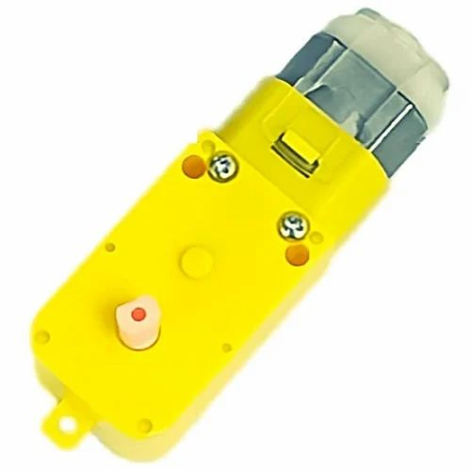
BO-Motor
Makes Things Move: The BO motor spins when connected to a battery, which helps move things like wheels in robots or toy cars.
Works with Batteries: It's powered by small batteries, so it's great for low-power projects.
Simple to Use: You can easily connect it to a motor driver or switch to make it go forward or backward.
Lightweight: It's small and doesn't weigh much, making it perfect for small robots or toys.
Slower and Steady: It doesn't spin as fast as other motors, but it provides steady movement for smooth control.
Applications: People use BO motors to move wheels in robots, cars, or simple machines.

Slide 6
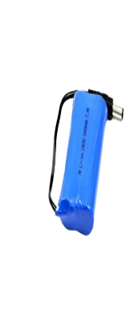
Battery
Gives Power: It supplies energy to things like robots, drones, or toys to make them work.
Two Cells: Inside, it has two smaller batteries (called cells) that add up to 7.4 volts.
Rechargeable: Most 7.4V batteries can be recharged, so you can use them again and again.
Applications: It’s perfect for powering robots, remote-controlled cars, or other electronic devices that need more power than regular AA batteries.
More Power: This battery is stronger than smaller ones like 3.7V, which means it can make motors or devices run faster or longer.

Slide 7
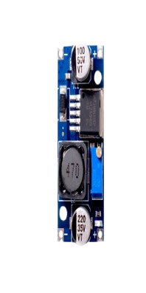
Buck converter(LM2596)
Lowers Voltage: If you have a battery that gives too much power (like 12V) and you need less (like 5V), the buck converter brings it down safely.
Protects Your Devices: It stops your electronics from getting damaged by too much voltage.
Efficient: It doesn’t waste much energy, so it keeps your battery lasting longer.
Adjustable: You can set it to give exactly the voltage you need, like 5V, 9V, or 3.3V, depending on your project.
Applications: Great for powering Arduinos, ESP32s, motors, or other devices that need a specific voltage from a bigger battery.

Slide 8
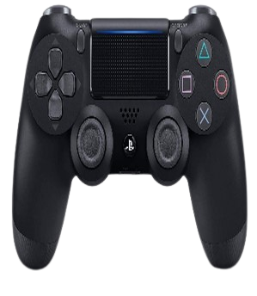
PS4 Controller
Used for Gaming: It helps you play games by controlling characters, cars, or whatever is happening in the game.
Buttons and Joysticks: It has joysticks for moving around and lots of buttons to jump, shoot, or interact with the game.
Wireless: It connects to the PlayStation without wires using Bluetooth, so you can sit comfortably while playing.
Vibrates: It can vibrate during games to make things feel more real, like when there’s an explosion or car crash.
Touchpad: There’s a touchpad in the middle that you can swipe or press to do special things in some games.
Used with Other Devices: You can also use it with computers or phones to play games or control projects, like the robot projects you're working on.

Slide 9
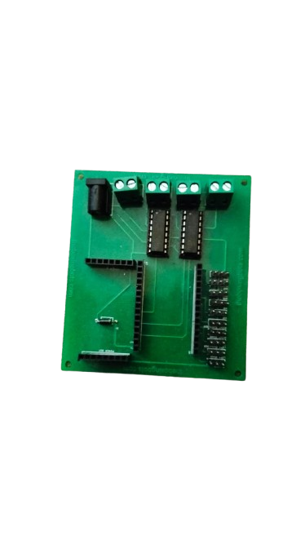
Boxing Bot PCB
PCB : The PCB means Printed Circuit Board
Power Supply: In the PCB there is DC power supply port is there. Here we can the battery for power supply for all components
Pins: In PCB pins is we can connected for servo motors
Places: The places are in-built for that places for ESP32 and Buck controller
Integrated Circuit(IC): Here we are used for L293D
L293D
Controls Motors: It lets you turn motors on, off, and change their direction (forward or backward).
Motors at Once: You can control motors at the same time with one L293D chip.
Needs Commands: It listens to commands from something like an Arduino or ESP32 to decide how the motors should move.
Protects the Circuit: It protects your circuit from getting damaged when controlling powerful motors.
Applications: It’s great for projects like robot cars, helping control the wheels and make the robot move.

Slide 10
Mechanical Components
Servo Motor
BO-Motor

Slide 11
Differences Between a Servo Motor and BO-Motor
Feature | Servo Motor | BO Motor (DC Motor)
Control | Controlled by PWM signals for precise angular positioning | Controlled by varying voltage or current, allowing continuous rotation
Position Control | Provides precise control over position and can hold a specific angle | Lacks positional feedback, so exact position control is difficult
Rotation Type | Typically limited to ~180° rotation (standard); some allow 360° | Capable of continuous 360° rotation
Torque and Speed | High torque at low speeds, suitable for precise movements | Higher speeds with variable torque
Control Circuit Complexity | Requires PWM signal and often a microcontroller | Simple control with power supply, though speed/direction need extra components
Application | Used in robotics, RC planes, and applications needing precise movement | Common in wheels of low-cost robotic cars and other continuous rotation tasks
Cost | Generally, more expensive due to internal control and feedback | Less expensive and widely available in different voltages and sizes

Slide 12
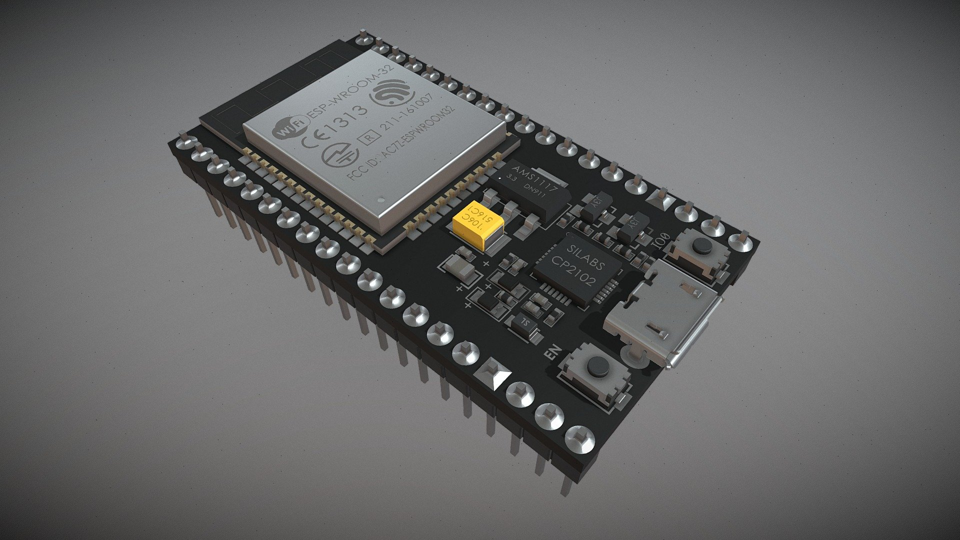
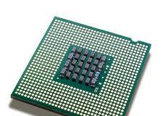
Electronics Components
Microcontroller
Microprocessor

Slide 13
Differences between Microprocessor and Microcontroller
Feature | Microprocessor | Microcontroller
Definition | A central processing unit (CPU) on a single chip, primarily focused on data processing | A complete system with CPU, memory, and peripherals on a single chip
Primary Use | Used in general-purpose computers, desktops, and laptops for high-performance computing | Used in embedded systems, appliances, and control-based applications
Components | Contains CPU only; memory, I/O, and peripherals are external | Integrates CPU, memory (RAM/ROM), I/O ports, and peripherals on a single chip
Power Consumption | Generally, consumes more power due to higher processing capabilities | Consumes less power, optimized for low-power applications
Cost | Typically, more expensive as it requires additional components for complete functionality | Generally cheaper as it combines several components into one chip
Complexity | More complex and requires external components to function fully | Simpler design, often self-contained, and ready to use in applications
Applications | Used in high-performance computing, gaming systems, and advanced computing tasks | Used in embedded systems like IoT devices, robotics, home appliances, and automotive systems

Slide 14
Boxing Bots Software Part

Slide 15
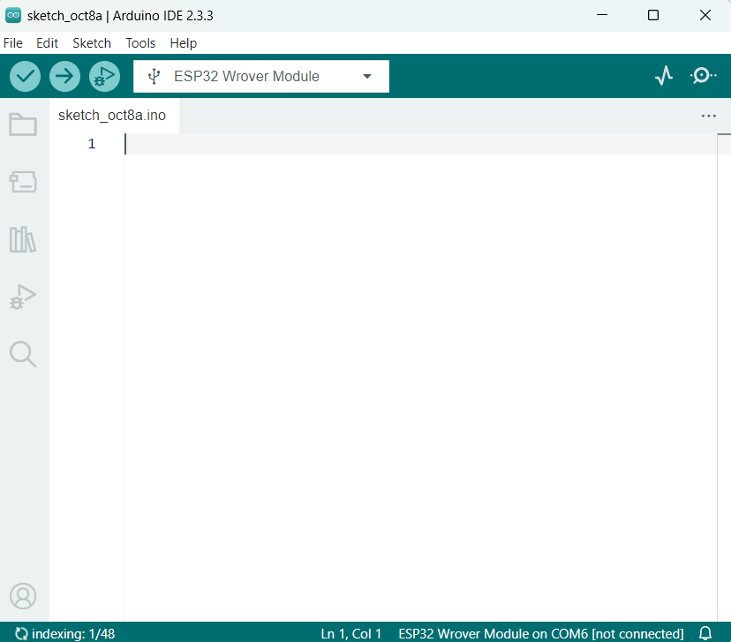
Open the Arduino IDE
Verify
Upload
Start Debugging
Board Selection

Slide 16
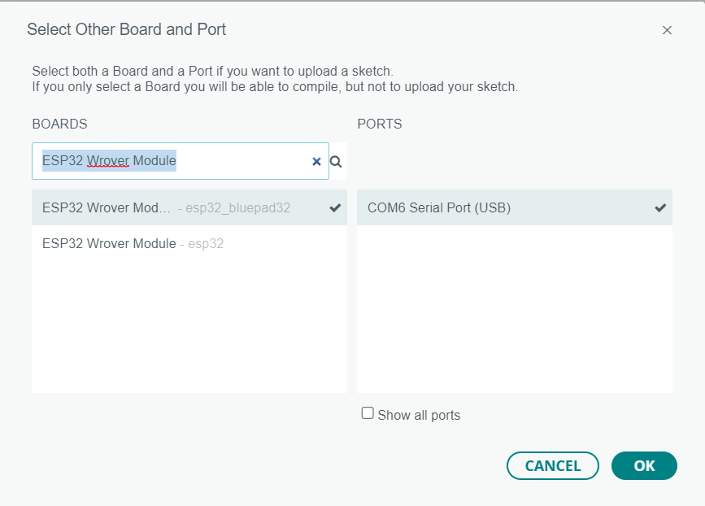
Click here and select the select board and port
Take esp32 and put the data cable connect the laptop after click Select Other Board And Port option after select your board

Slide 17
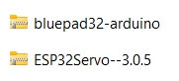
Installing Libraries
Before upload, the code you need to install some libraries
The Libraries we are going to use are BluePad and ESP32Servo
Download the BluePad library from this link: https://drive.google.com/file/d/180baXoa0R7iAdNfYnandzdZnZ_7xVNxA/view?usp=sharing
Download the ESP32Servo library from here: https://drive.google.com/file/d/18nCegdBoKxQqiLX_Cmjle3FvIoWNc1KC/view?usp=sharing
Protects the Circuit: It protects your circuit from getting damaged when controlling powerful motors.
Used in Robots: It’s great for projects like robot cars, helping control the wheels and make the robot move.

Slide 18
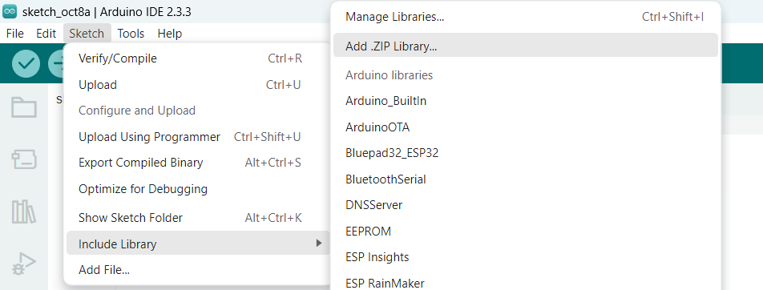
Installing Libraries
Click the Sketch option → click the Include library → click the Add.zip library…

Slide 19
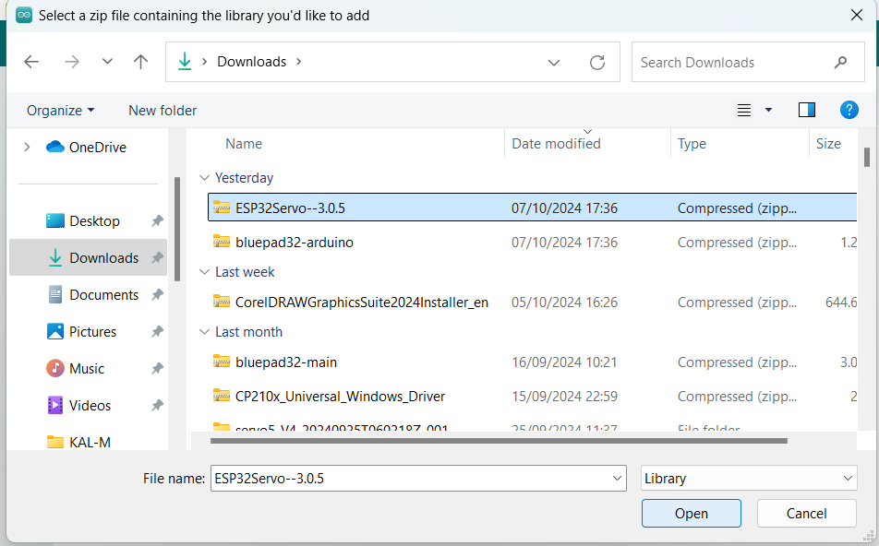
Installing Libraries
Select the libraries and click the open option…
Please note this must be done for all the libraries or else you will face error while compiling the program.

Slide 20

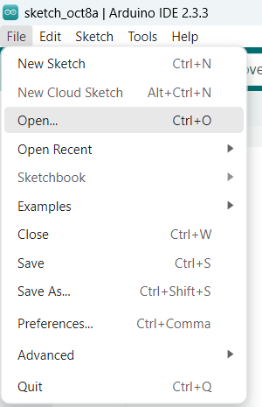
Working on the Code
Download the code which is in .ino file from the below link. The name of the file will be Boxing_bots_final_code.ino
Link:- https://drive.google.com/file/d/1aQZFsEYzAivfqZXAkvNaXNu96egA1YOD/view?usp=sharing
Open the Arduino IDE → click file option → click open option

Slide 21
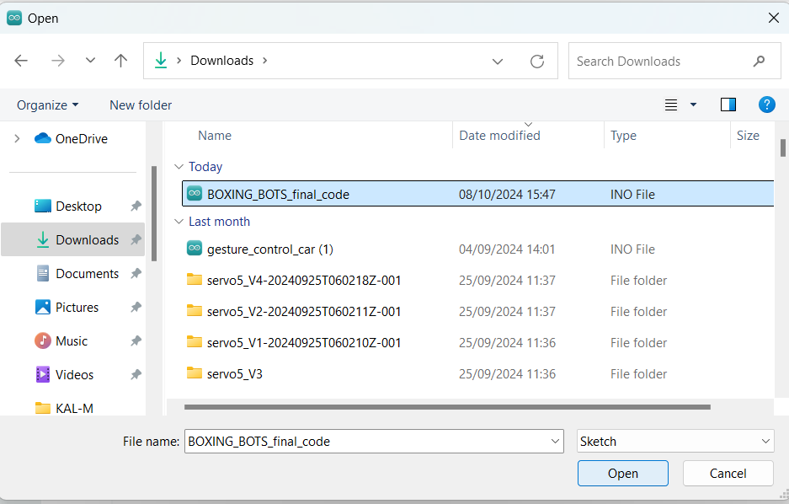
Working on the Code
select the code file and click open

Slide 22
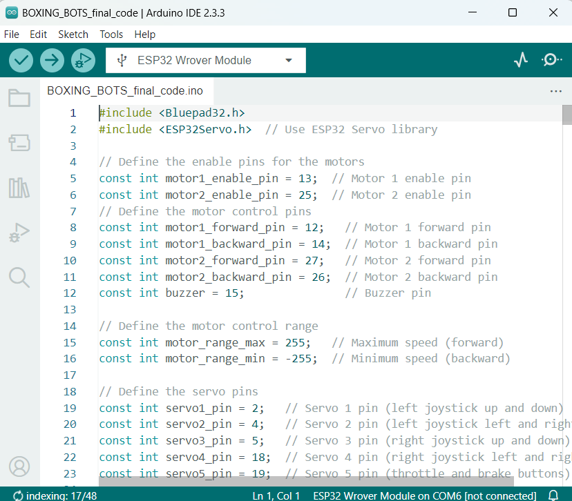
Working on the Code
The code will be opening in Arduino IDE
Click the verify option → verify the code if its correct.
No errors → Upload the code via clicking Upload option
Note: In case you find the errors solve the errors → upload the code

Slide 23
Errors in Boxing Bots

Slide 24
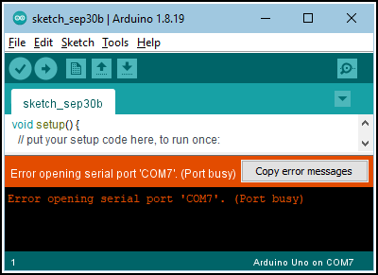
Port Error in Arduino IDE
Answer: The download the ch340 driver and install in your Laptop or System
Link:- https://drive.google.com/file/d/18nCegdBoKxQqiLX_Cmjle3FvIoWNc1KC/view?usp=sharing

Slide 25
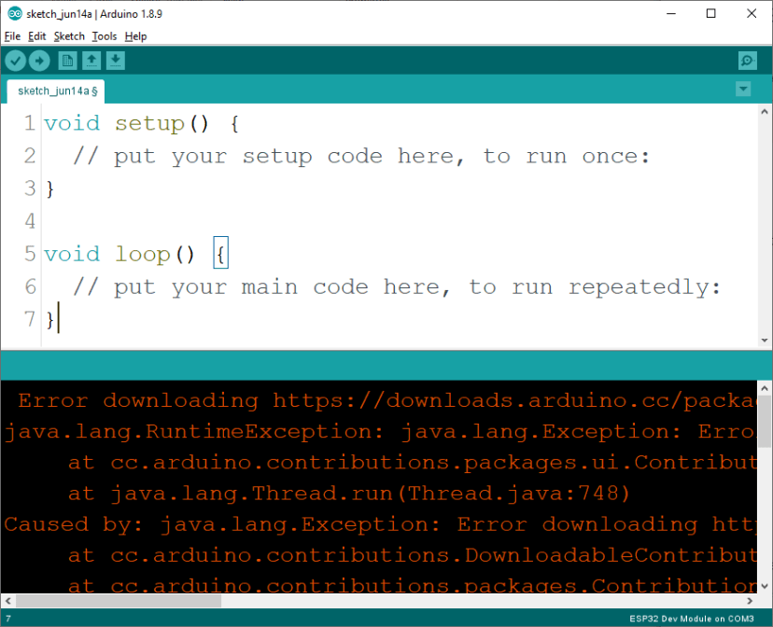
Board Error in Arduino IDE
Board link:- https://dl.espressif.com/dl/package_esp32_index.json
Add that link in Preferences…

Slide 26
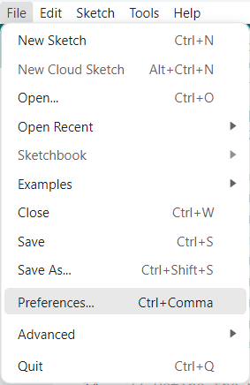
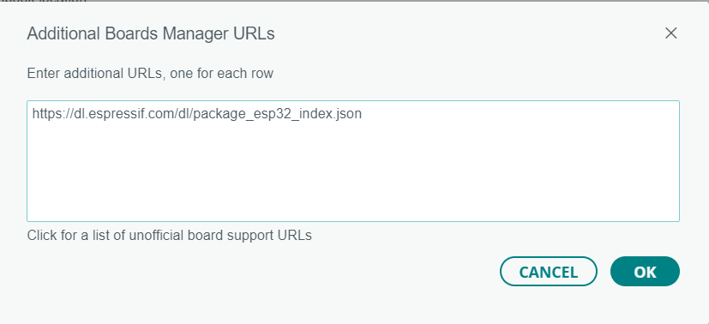
Click file option → select preferences
Click preferences → Click Additional boards manager URLs →Paste the link → click OK button

Slide 27
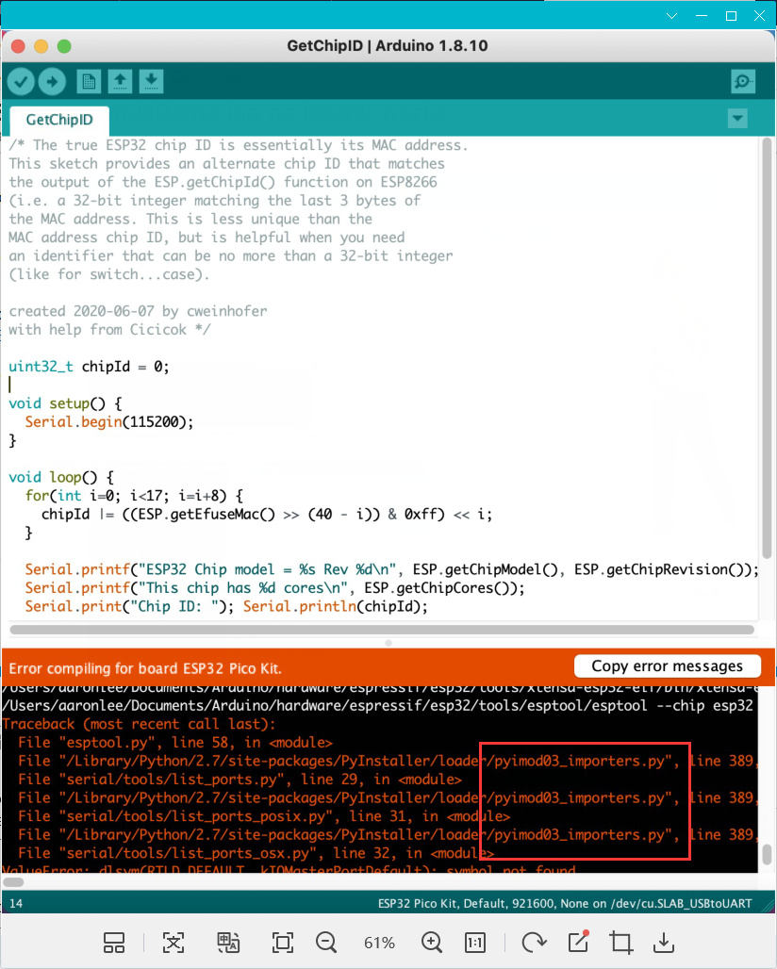
Library Error

Slide 28
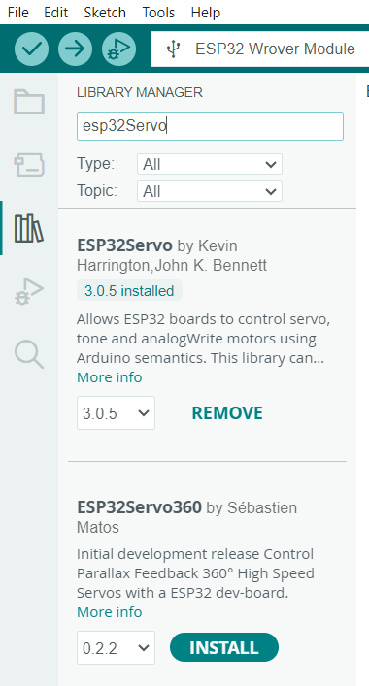
Libraries
Click Library Manager → Download library → Related the libraries

Slide 29
Introduction to CP2102 Driver
What is CP2102?
A USB-to-UART bridge controller
Manufactured by Silicon Labs
Purpose of the Driver
Enables communication between USB and UART (Universal Asynchronous Receiver-Transmitter) devices
Common Applications
Microcontrollers, IoT devices, serial communication for data transfer

Slide 30
Features and Benefits of CP2102 Driver
Key Features:
USB 2.0 compatible, full-speed (up to 12 Mbps)
Integrated clock, no external crystal required
No external USB components needed (single-chip solution)
Benefits:
Easy integration for embedded systems
Provides reliable, stable data transfer
Plug-and-play with major operating systems (Windows, macOS, Linux)

Slide 31
Installation and Troubleshooting
Driver Installation Steps
Download the driver from Silicon Labs website
Install the driver according to OS-specific instructions
Troubleshooting Tips
Check device manager for connection status
Reinstall the driver if device not recognized
Ensure correct port settings in serial communication software

Slide 32
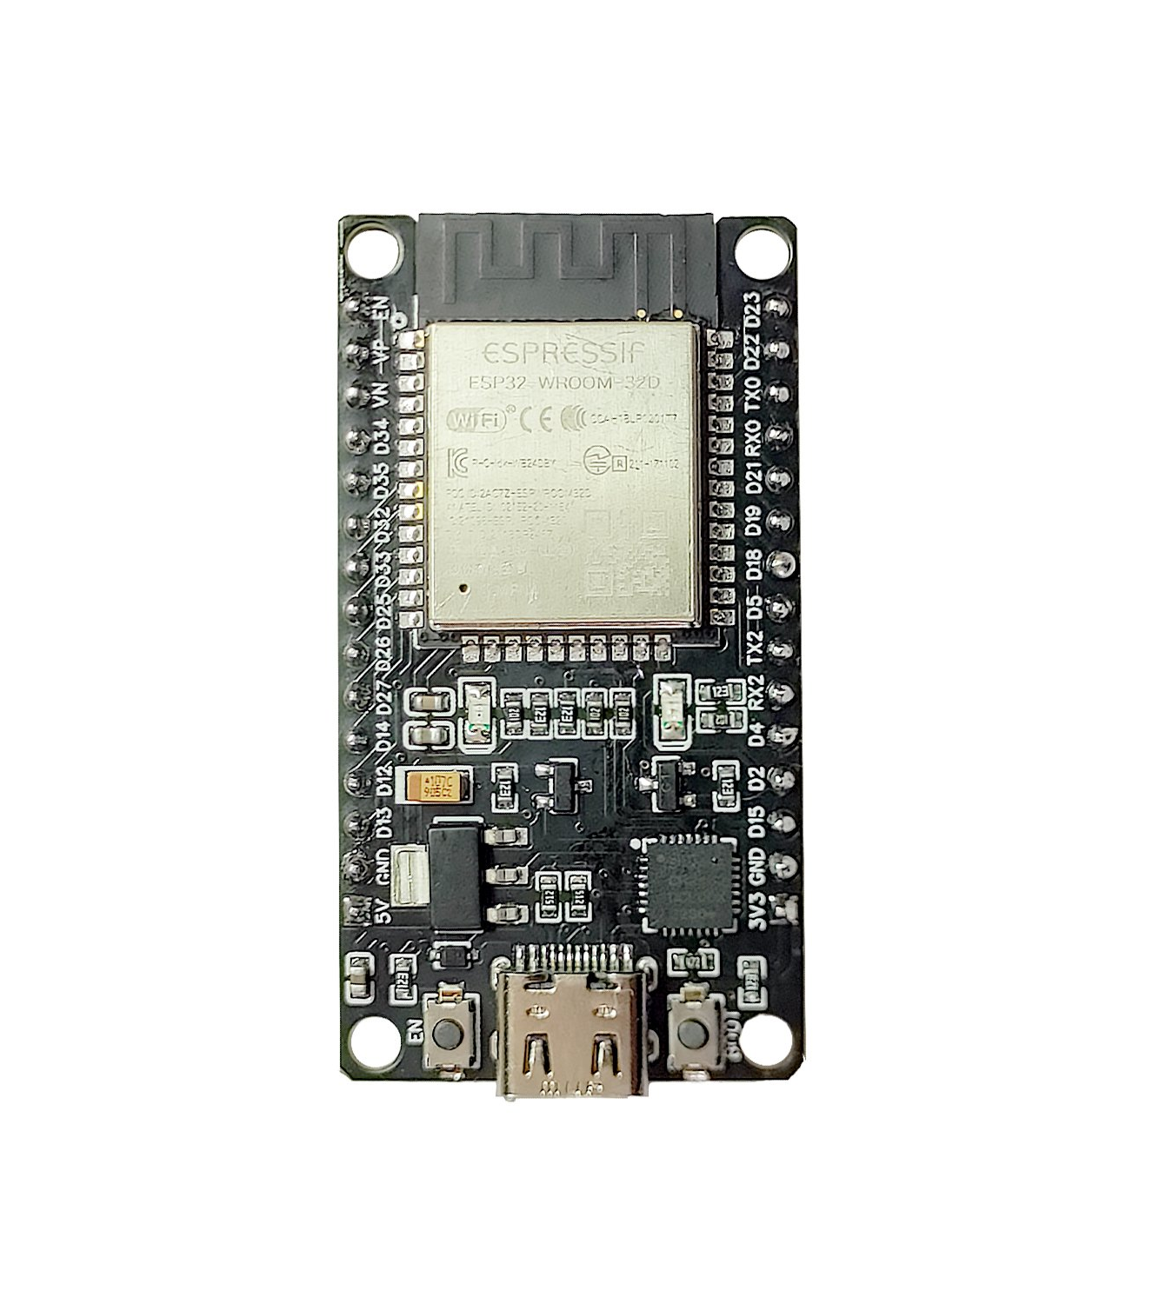
ESP32

Slide 33
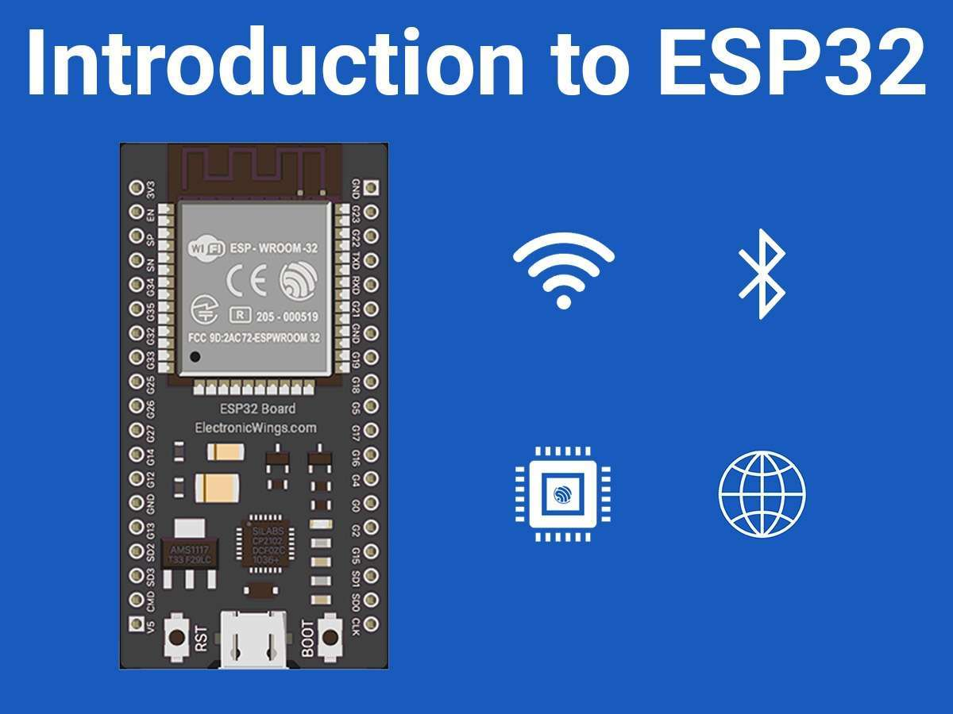
What is ESP32?
ESP32 is a small, powerful microcontroller.
It can control devices like lights, sensors, and motors.
Has built-in Wi-Fi and Bluetooth for wireless communication.
It’s affordable and beginner-friendly.

Slide 34
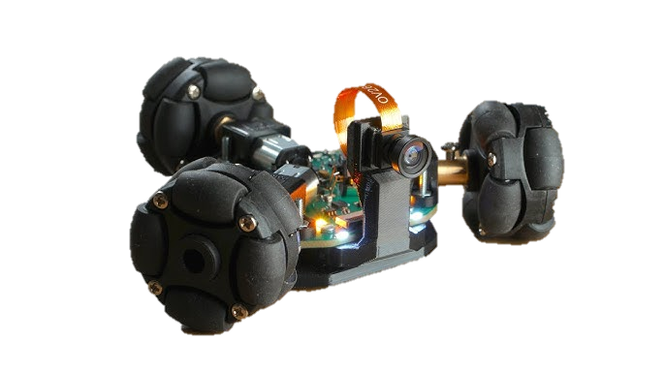
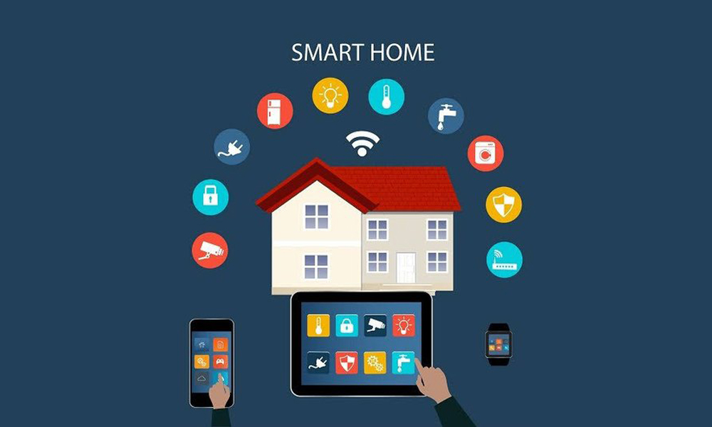
Why is ESP32 Cool?
Key Features:
Wi-Fi and Bluetooth built-in
Fast and can handle multiple tasks
Connects to many devices like sensors and motors
What Can You Make?
Smart home devices
Robots
Weather stations or games

Slide 35



Simple ESP32 Projects
LED Blinker: Control an LED
Wi-Fi Car: Drive a robot car using your phone’s Wi-Fi.
Smart Home: Control devices wirelessly using ESP32.

Slide 36
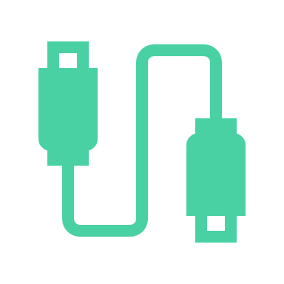




Getting Started
What You Need:
ESP32 board, USB cable, and Arduino IDE
LEDs, buttons, or sensors for simple projects
Learning Resources:
Online tutorials
Practice by building projects and experimenting!

Slide 37
Working Principle and Process of DC Motor

Slide 38
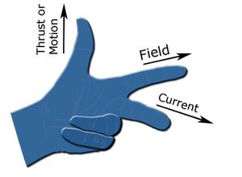
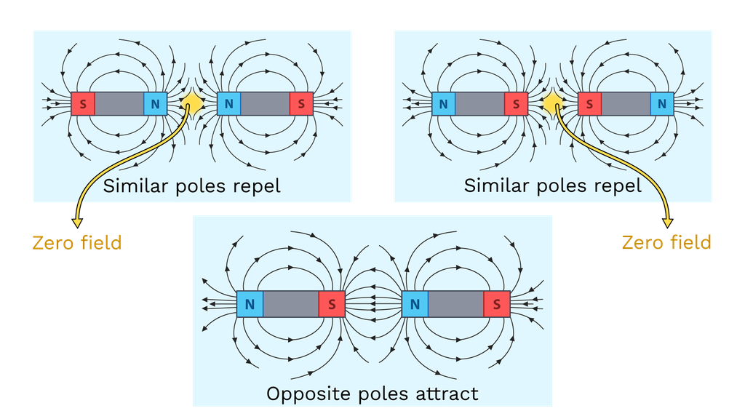
How a DC Motor Works
A DC motor works on Fleming's Left-Hand Rule.
In a DC motor, we use this idea: When electricity flows through a wire, it acts like a Magnet!
The motor uses electricity and magnets to make something spin, just like fan or toy car’s wheels.

Slide 39
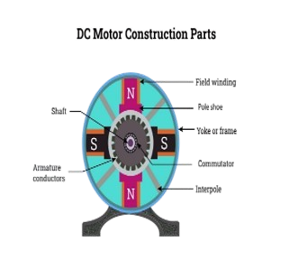
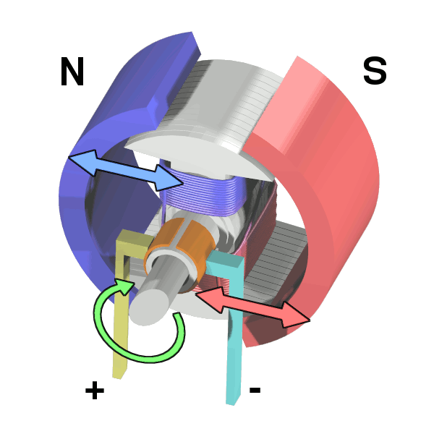
How Does a DC Motor Spin?
Electricity goes into the motor. This creates a magnetic field
As it spins, the motor keeps reversing the direction of electricity to keep it going.
Example: Think about your remote-control car. The motor inside makes the wheels turn when you press the button.
The magnetic force pushes a part of the called the armature to spin.
This spinning part can make things move, like wheels or fans.

Slide 40
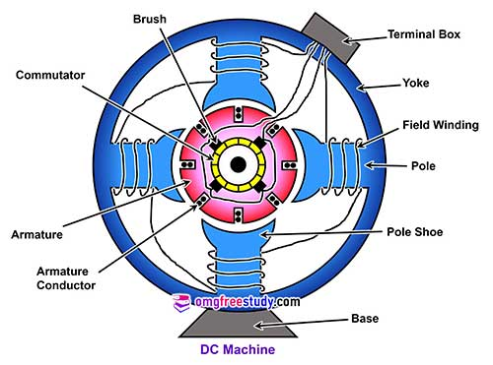
Key Components of a DC Motor
Stator: The part that stays still. It makes the magnetic field.
Rotor (Armature): The part that spins, using electricity and magnets.
Commutator and Brushes: They help the motor switch the flow of electricity to keep spinning in one direction.
Example: In a fan, the part that spins the blades.

Slide 41
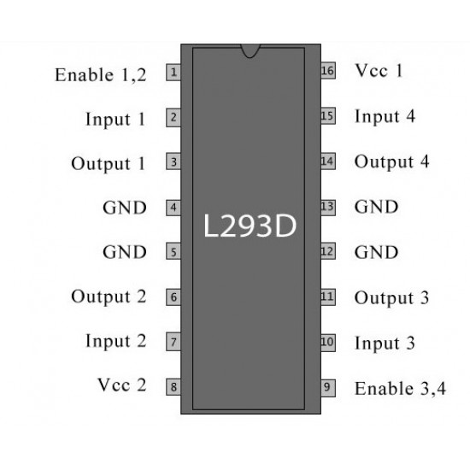
L293D Motor Driver Board

Slide 42
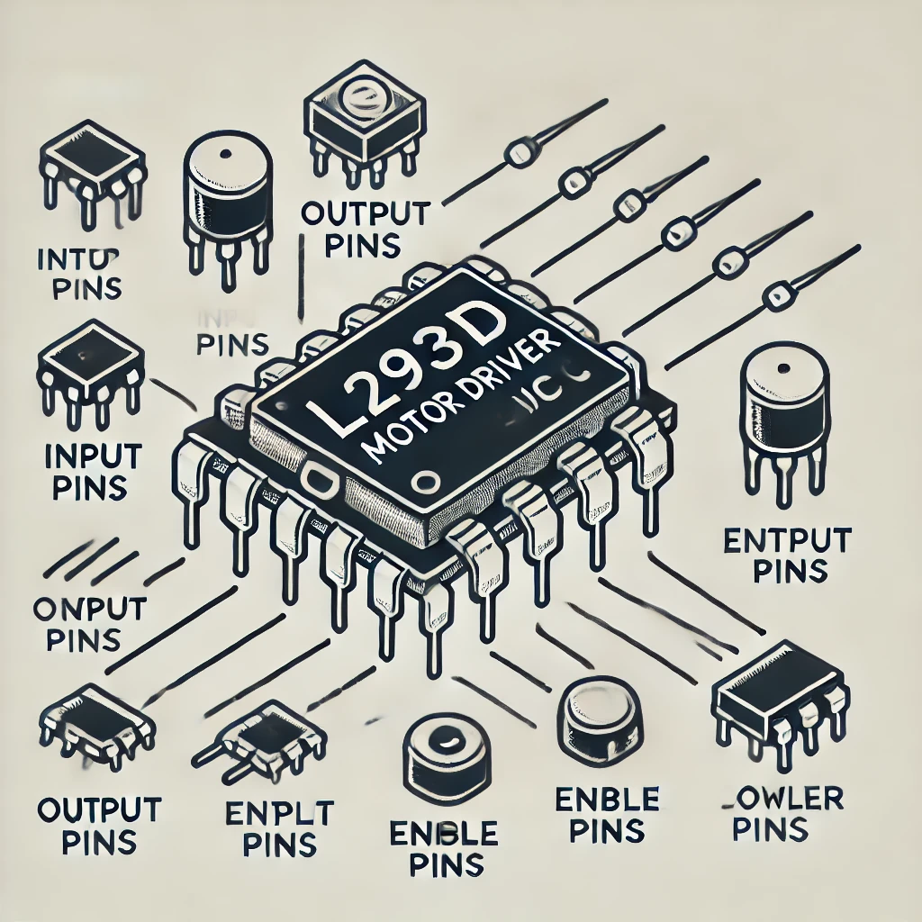
What is the L293D Motor Driver?
It’s an integrated circuit used to control motors.
Allows you to control the speed and direction of two DC motors at once.
Acts as a bridge between your microcontroller (like Arduino or ESP32) and motors.
Simple and easy to use for projects involving motors.

Slide 43
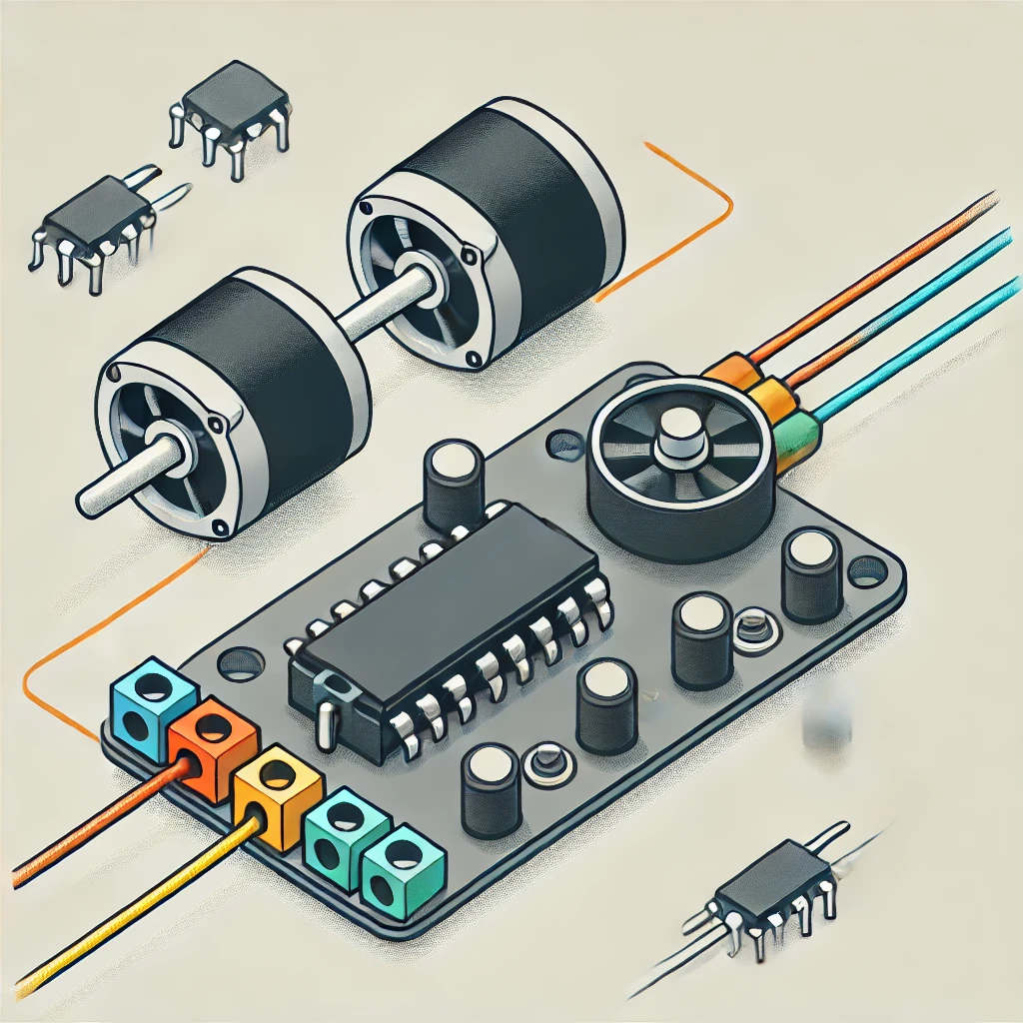
How the L293D Controls Motors
It uses H-bridge circuits to control motor direction.
Can control 2 DC motors or 1 stepper motor.
Takes low-power input signals (from a microcontroller) and controls high-power motors.
Has four input pins to control motor movement.

Slide 44
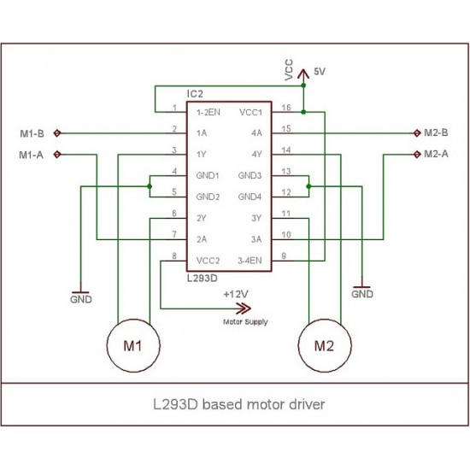
Pin Layout of L293D
Image of the L293D with pin labels.
Main Pins:
Input Pins (1A, 2A, 3A, 4A) for controlling motors.
Output Pins (1Y, 2Y, 3Y, 4Y) connected to motors.
Enable Pins to activate the motors.
Vcc (Power) for motor power supply.
Simple explanation of key pin roles.

Slide 45
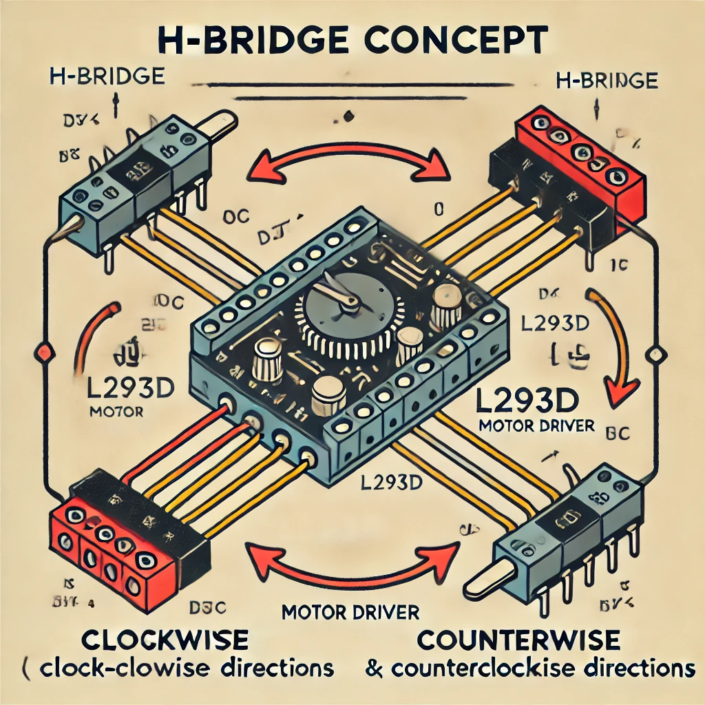
How to Use the L293D in Your Projects
Connect to microcontroller (like Arduino) using input pins.
Attach motors to the output pins.
Control the direction and speed of motors using code.
Example projects: RC cars, robotic arms, obstacle-avoiding robots.

Slide 46
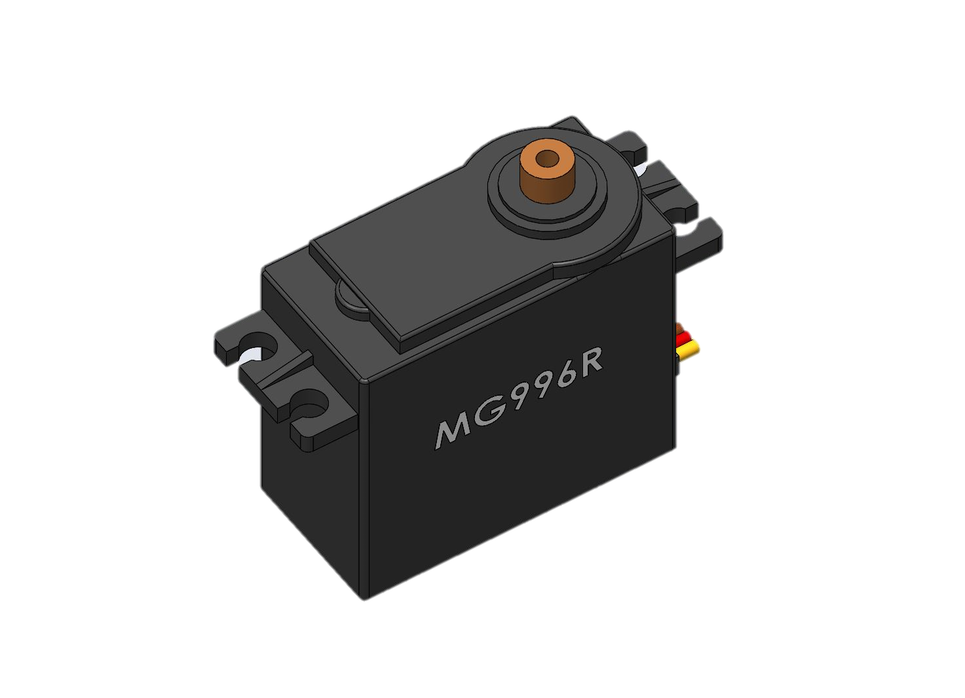
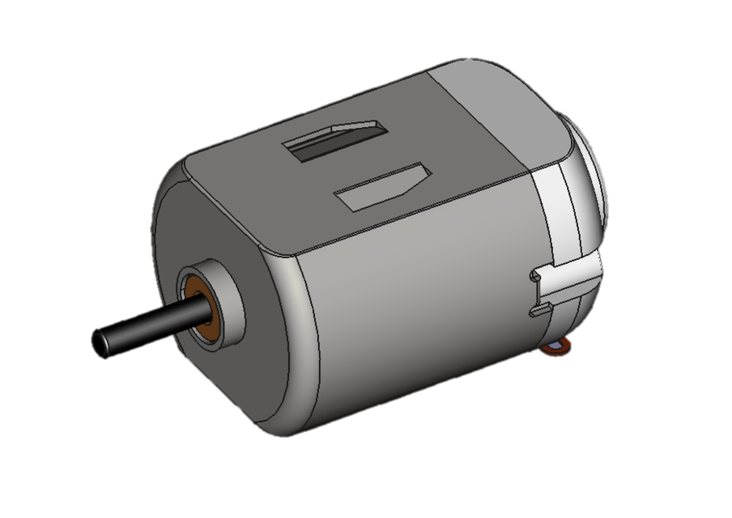
Servo Motors vs DC Motors
VS

Slide 47
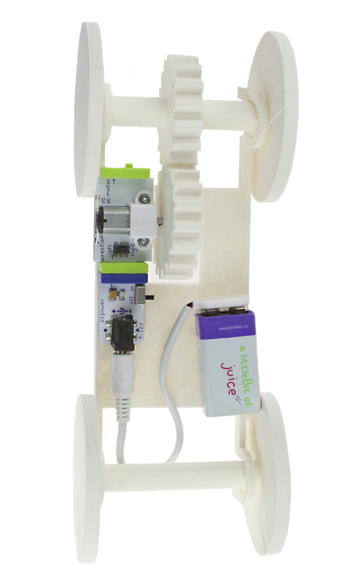
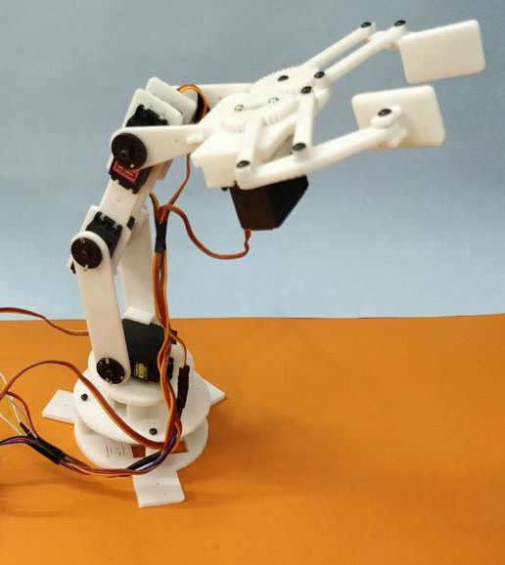
What are DC Motor and Servo Motors?
DC Motor:
Definition: An electric motor that runs on direct current (DC).
Function: Converts electrical energy into mechanical motion.
Applications: Toys, fans, and electric vehicles.
Servo Motor:
Definition: A motor that provides precise control of position and speed.
Function: Can move to a specific angle and hold that position.
Applications: Robotics, remote-controlled cars, and camera systems.

Slide 48
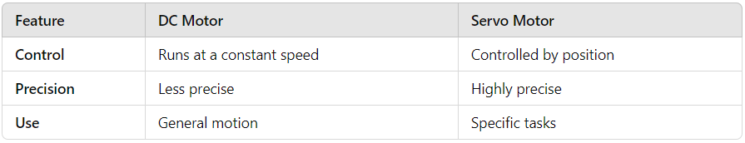
Key Differences

Slide 49
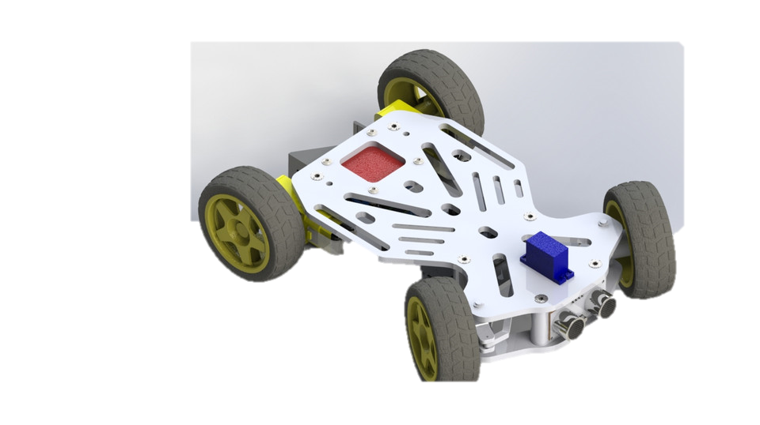
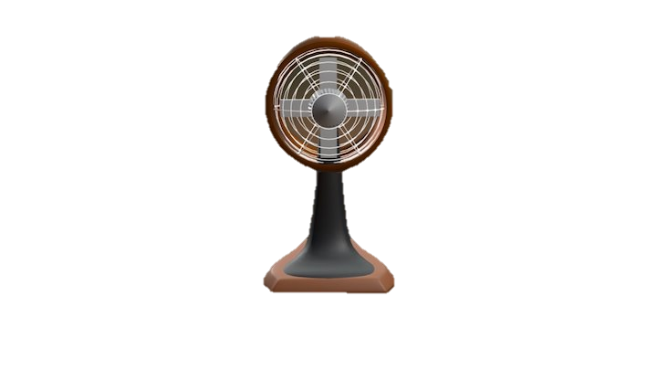
Applications of DC Motors and Servo Motors
Remote-Controlled Cars:
Controls steering and throttle for better maneuverability.
Example: Racing RC cars.
Fans:
Commonly used in cooling fans for computers and HVAC systems.
Example: Desk fans.

Slide 50
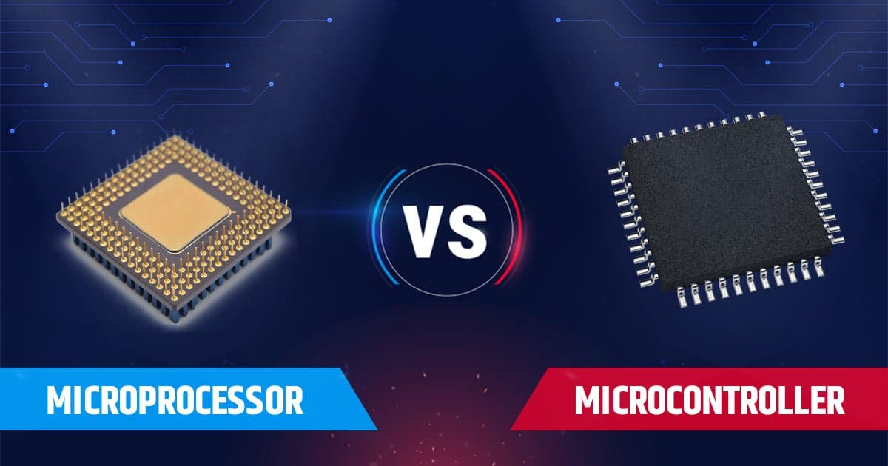
Microprocessor VS Microcontroller

Slide 51
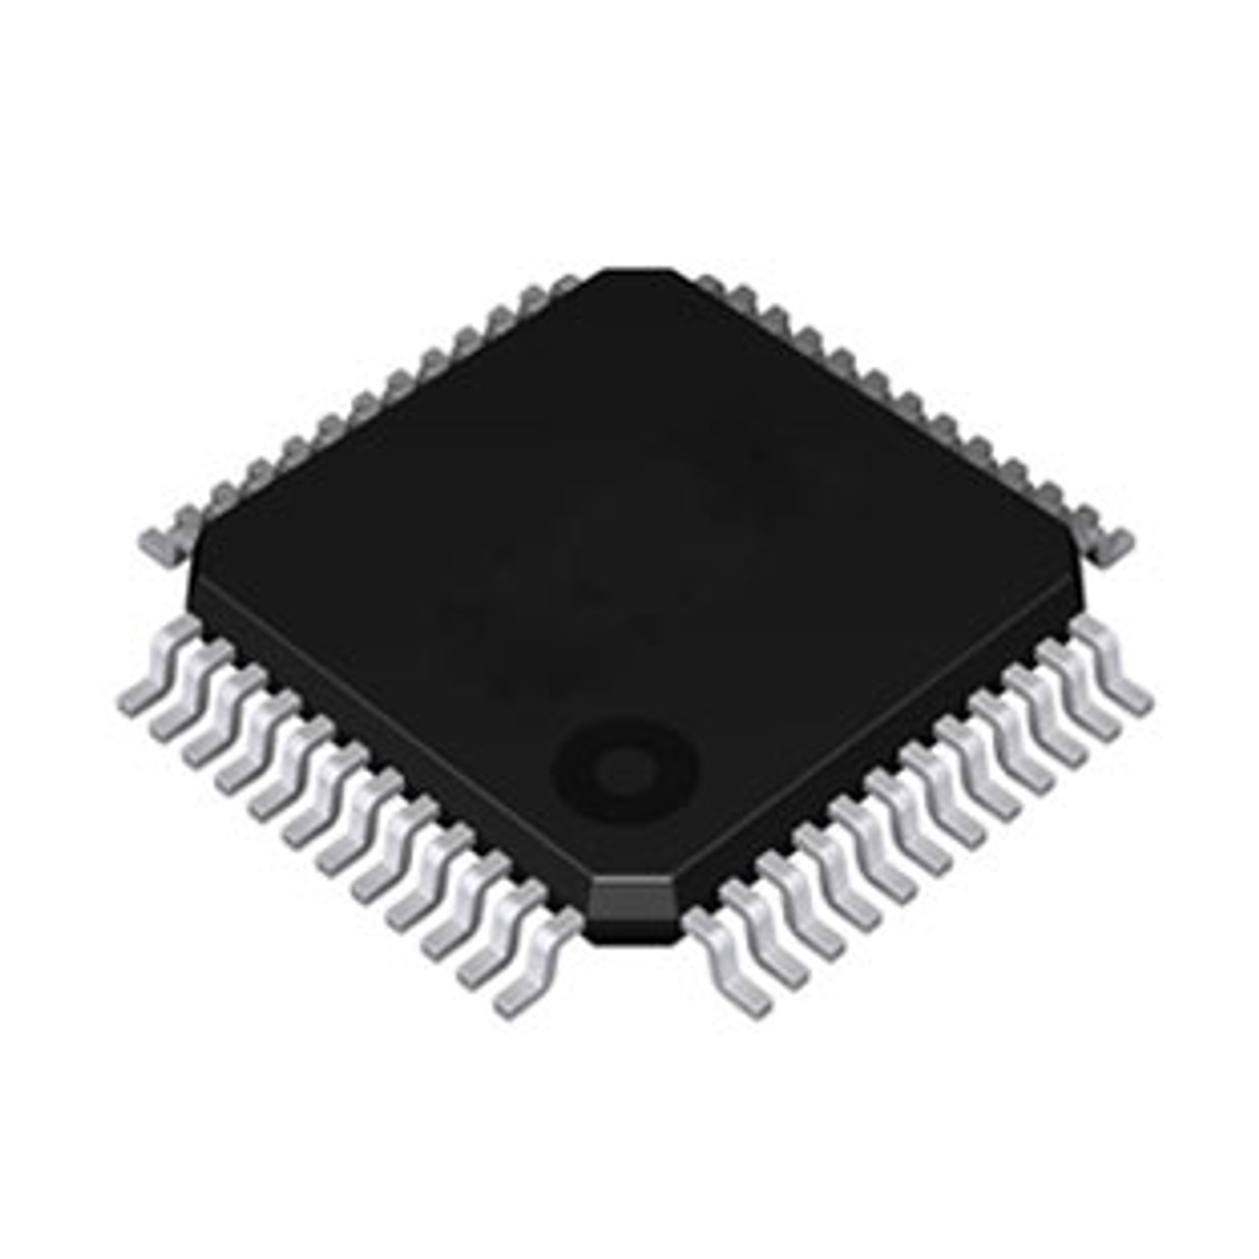
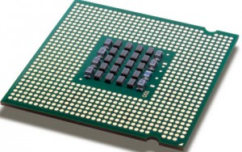
Introduction to Microcontrollers and Microprocessors
Microcontroller: A compact integrated circuit designed to govern a specific operation in an embedded system. It includes a CPU, memory (RAM/ROM), and peripherals.4
Microprocessor: A more powerful processing unit that performs arithmetic and logic operations. It lacks integrated memory and requires external components.

Slide 52
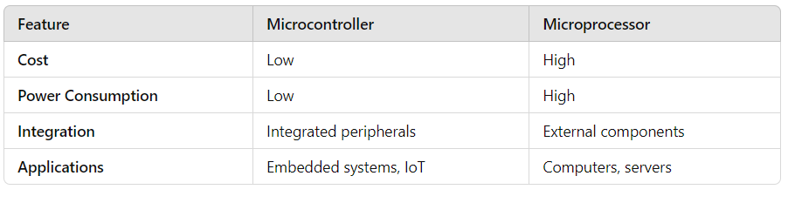
Key Differences

Slide 53

Applications
Microcontrollers:
- Home automation (e.g., smart thermostats)
- Robotics (e.g., Arduino, ESP32)
- Automotive control systems
Microprocessors:
- Personal computers
- Mobile devices (e.g., smartphones, tablets)
- High-performance servers

